Slide 1


IAM Platform Implementation Plan for TechCorp
Secure, Scalable, and Aligned with Business Growth
Presented by: [Your Name] | Date: [Date]
by Ali Rayyan

Slide 2

Objectives of IAM Implementation
Enhance Security
Reduce risk of data breaches through robust access controls.
Streamline Access
Simplify and unify resource access across the enterprise.
Support Digital Transformation
Enable seamless global and cloud operations integration.
Improve User Experience
Enhance ease of access for employees, partners, and customers.

Slide 3
Implementation Roadmap Overview
Phase 1
1
Planning & Discovery (Weeks 1–3)
Phase 2
2
Design & Architecture (Weeks 4–6)
Phase 3
3
Development & Integration (Weeks 7–14)
Phase 4
4
Testing & Validation (Weeks 15–18)
Phase 5
5
Deployment & Training (Weeks 19–21)
Phase 6
6
Monitoring & Continuous Improvement (Ongoing)

Slide 4

Phase 1: Planning & Discovery
Governance Setup
Identify key stakeholders and establish IAM governance team.
Scope Definition
Define project scope, KPIs, and success criteria clearly.
Process Assessment
Evaluate current IAM tools and processes for gaps.
Systems Inventory
Catalog systems and applications for integration planning.
Resources Needed: IAM consultants, business analysts, IT security leads

Slide 5
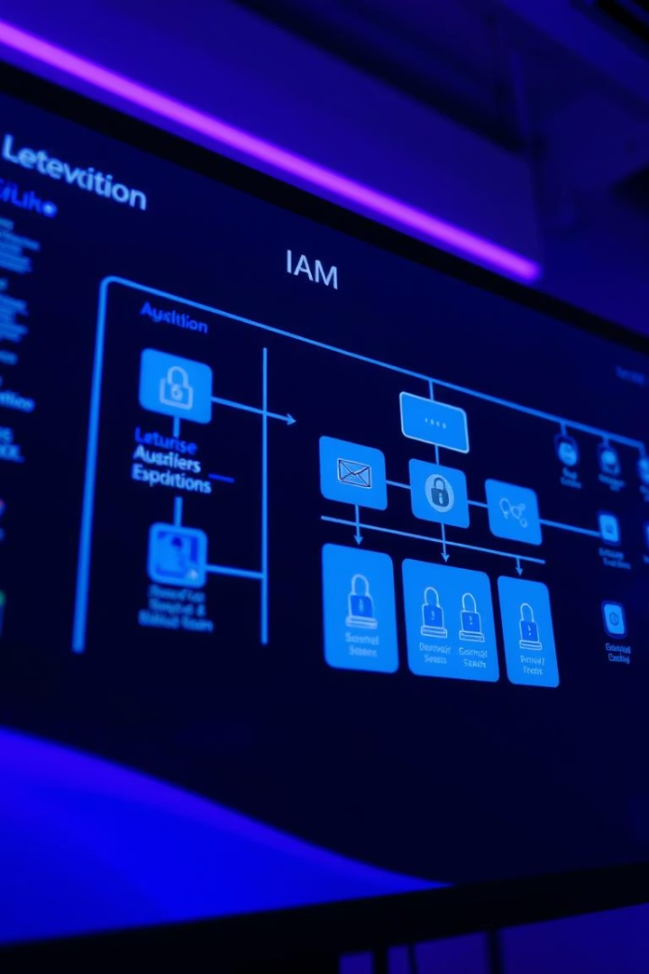



Phase 2: Design & Architecture
Architecture Development
Create target IAM system design for scalability and security.
Role Models & Policies
Define RBAC and PBAC role models and access policies.
Integration Planning
Plan connectivity with HRMS, Active Directory, Cloud, and third parties.

Slide 6
Phase 3: Development & Integration
Platform Configuration
Systems Integration
User Portals & Workflows
Resources
Connect HRMS via SCIM/APIs, integrate with AD and cloud environments.
IAM engineers, system integrators, and developers involved.
Set up IAM tools like SailPoint or Okta for TechCorp.
Build self-service portals and automate approval workflows.

Slide 7

Phase 4: Testing & Validation
1
Testing Types
2
Workflow Validation
Unit, system, and user acceptance testing (UAT) rigorously executed.
Confirm correct provisioning and de-provisioning processes.
3
Security Simulation
4
Certification Dry Runs
Conduct penetration testing to identify vulnerabilities.
Practice access certificate reviews before live audits.

Slide 8

Phase 5: Deployment & Training
1
Controlled Go-Live
Initial launch in controlled environment to minimize risk.
2
Phased Rollout
Deploy critical systems first, then enterprise-wide rollout.
3
Role-Based Training
Conduct training sessions targeted to user roles and responsibilities.
4
Helpdesk Support
Provide ongoing user assistance and issue resolution post deployment.

Slide 9
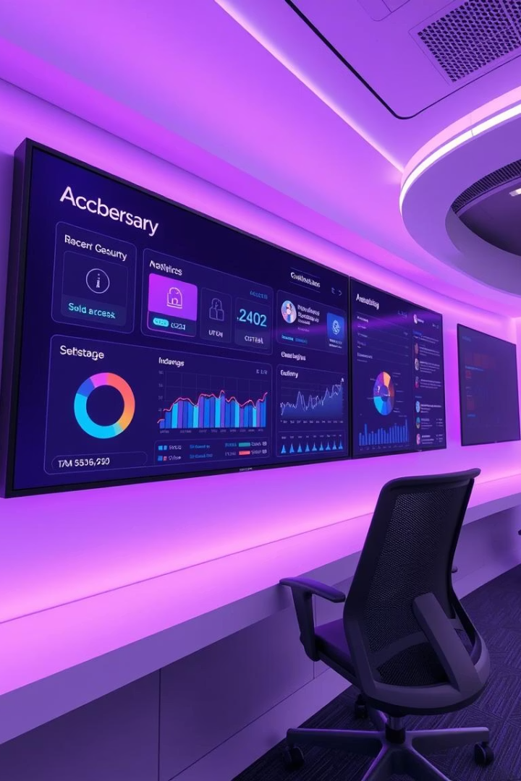
Phase 6: Monitoring & Continuous Improvement
Real-Time Dashboards
SIEM Integration
Display key IAM metrics and access visibility 24/7.
Monitor and analyze access logs with Security Information and Event Management systems.
Policy Reviews
Schedule regular audits to ensure policy adherence and relevance.

Slide 10

Key Takeaways & Next Steps
Summary
Project Phases
IAM implementation strengthens security and streamlines access.
Six phases guide systematic deployment and integration.
Continuous Improvement
Next Steps
Ongoing monitoring ensures agility and compliance.
Finalize governance, begin planning phase immediately.

